Slide 1
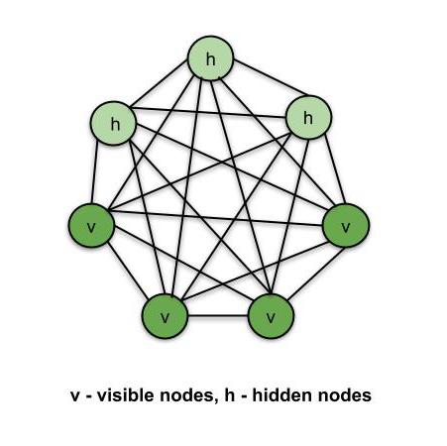
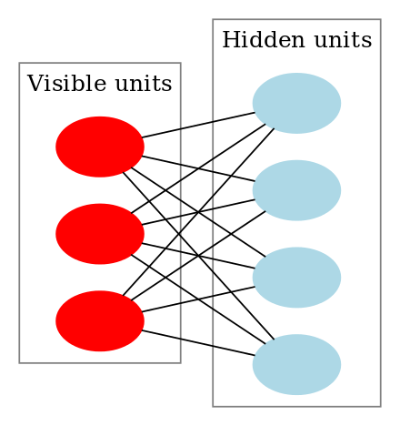
Boltzmann Machines
Boltzmann Machines is an unsupervised DL model in which every node is connected to every other node.
Boltzmann Machines are undirected (or the connections are bidirectional).
There are two types of nodes in the Boltzmann Machine
Visible nodes — those nodes which we can and do measure
Hidden nodes – those nodes which we cannot or do not measure.
Boltzmann Machine is a kind of recurrent neural network
Output from previous step are fed as input to the current step.
At least one feedback loop
With self feed-back links

Slide 2
Boltzmann Learning
Types of Boltzmann machines
Restricted Boltzmann Machines (RBMs)
Deep Belief Networks (DBNs)
Deep Boltzmann Machines (DBMs)
Applications:
Dimensionality reduction
Classification
Collaborative filtering
Feature learning
Body quantum mechanics

Slide 3
Learning Rules
Learning with a teacher (supervised learning)
Learning without a teacher (unsupervised learning and reinforcement learning).

Slide 4
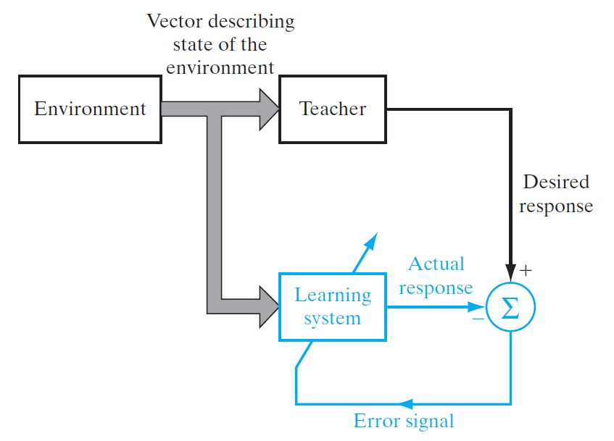
Learning with a teacher (supervised learning)
The teacher as having knowledge of the environment and unknown to the neural network.
The teacher is able to provide the neural network with a desired response for that training vector. Indeed, the desired response represents the "optimum" action to be performed by the neural network.
The network parameters are adjusted under the combined influence of the training vector and the error signal.

Slide 5
Learning with a teacher (supervised learning)
The error signal is defined as the difference between the desired response and the actual response of the network.
This adjustment is carried out iteratively in a step-by-step fashion with the aim of eventually making the neural network emulate the teacher; the emulation is presumed to be optimum in some statistical sense.
In this way, knowledge of the environment available to the teacher is transferred to the neural network through training.
When this condition is reached, we may then dispense with the teacher and let the neural network deal with the environment completely by itself.

Slide 6
Learning without a teacher
However, in learning without a teacher, there is no teacher to oversee the learning process.
Hence, there are no labeled examples of the function to be learned by the network.
In unsupervised, or self-organized, learning is done without the supervision of a teacher.
The goal of unsupervised learning is to find the underlying structure of dataset, group that data according to similarities
Under this second paradigm, two subdivisions are identified.
Reinforcement learning
Unsupervised learning

Slide 7
Learning without a teacher- Unsupervised learning
To perform unsupervised learning, use a competitive-learning rule.
Use a neural network that consists of two layers, an input layer and a competitive layer.
The input layer receives the available data.
The competitive layer consists of neurons that compete with each other (in accordance with a learning rule) for the "opportunity" to respond to features contained in the input data.
The network operates in accordance with a "winner-takes-all" strategy.
In such a strategy, the neuron with the greatest total input "wins" the competition and turns on; all the other neurons in the network then switch off.

Slide 8
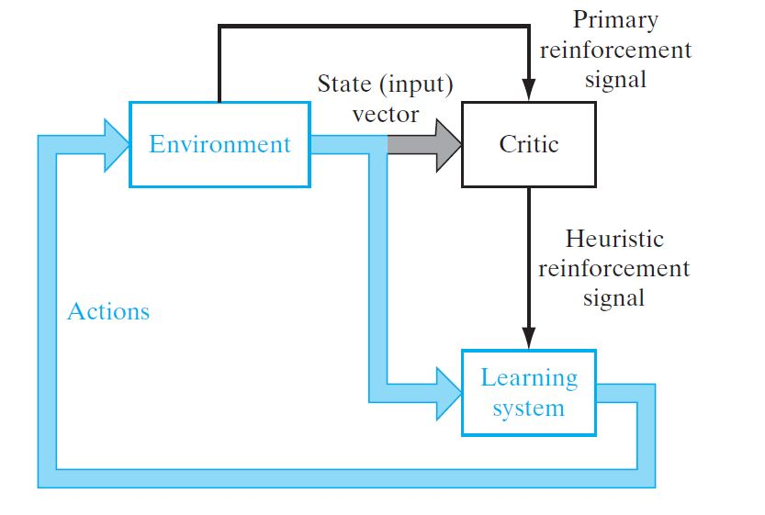
Learning with a teacher (supervised learning)
Reinforcement Learning is a feedback-based Network technique in which an agent learns to behave in an environment by performing the actions and seeing the results of actions.
For each good action, the agent gets positive feedback, and for each bad action, the agent gets negative feedback or penalty.
Since there is no labeled data, so the agent is bound to learn by its experience only.

Slide 9
Learning with a teacher (supervised learning)
The agent interacts with the environment and explores it by itself. The primary goal of an agent in reinforcement learning is to improve the performance by getting the maximum positive rewards.
The goal of reinforcement learning is to minimize a cost-to-go function, defined as the expectation of the cumulative cost of actions taken over a sequence of steps instead of simply the immediate cost.

Slide 10
Learning Tasks
Pattern Association / Completion
Pattern Recognition
Function Approximation
Beamforming
Classification
Optimization
Feature Detection
Data Compression
Prediction

